Slide 1


Algorithms in Logic (096265)
Elad Kapuza
Adam Goldbraikh

Slide 2
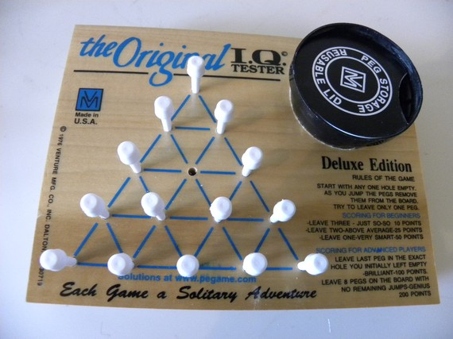
Game Puzzle

Slide 3
Rules of The Game

Slide 4
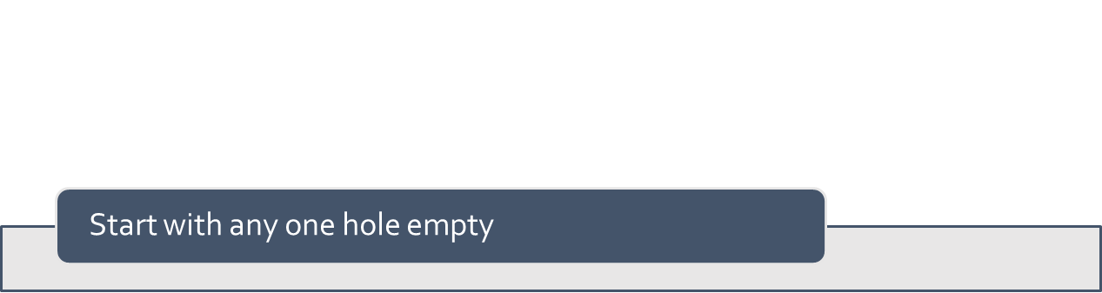
Rules of The Game

Slide 5
Rules of The Game
Start with any one hole empty
As you jump the pegs remove them from the board

Slide 6
Rules of The Game
Try to leave only one peg
As you jump the pegs remove them from the board
Start with any one hole empty

Slide 7
Rules of The Game
Try to leave only one peg
As you jump the pegs remove them from the board
Start with any one hole empty
Damka-based moves

Slide 8
Rules of The Game

Slide 9
Rules of The Game

Slide 10
Rules of The Game

Slide 11
Rules of The Game

Slide 12
Rules of The Game

Slide 13
Rules of The Game

Slide 14
Rules of The Game

Slide 15
Logical Modeling Classic Game

Slide 16
Definitions (1) - Graph

Slide 17
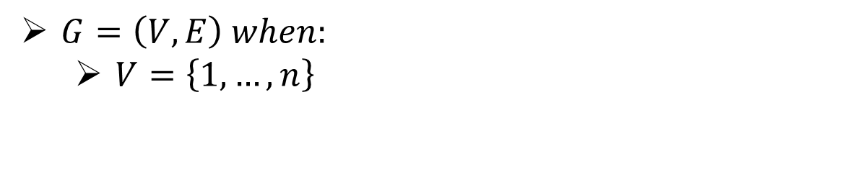
Definitions (1) - Graph
$G=\left(V,E\right) when:$
$V=\left\{1,…,n\right\}$

Slide 18
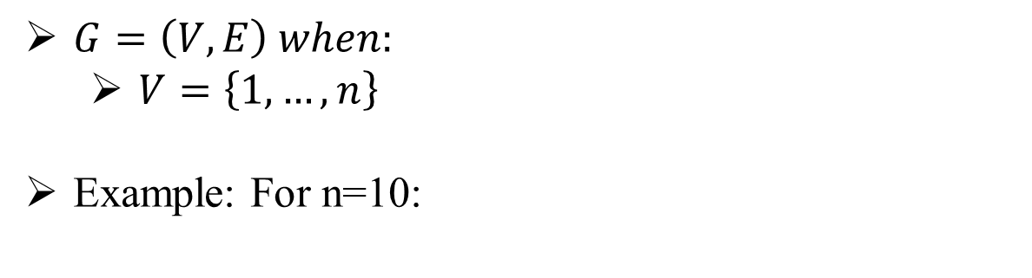
Definitions (1) - Graph
$G=\left(V,E\right) when:$
$V=\left\{1,…,n\right\}$
Example: For n=10:

Slide 19
Definitions (1) - Graph
$G=\left(V,E\right) when:$
$V=\left\{1,…,n\right\}$
Example: For n=10:
1
2
3
4
5
6
7
8
9
10

Slide 20
Definitions (2) - Neighbors
n6
n1
n5
v
n2
n4
n3
Notes:
לכל צומת יש רשימת שכנים כך שכל שכן מוגדר לכיוון מסויים. לכל היותר יתכנו 6 שכנים ולכן גם שישה כיוונים שונים.

Slide 21
Definitions (3) - Sets

Slide 22
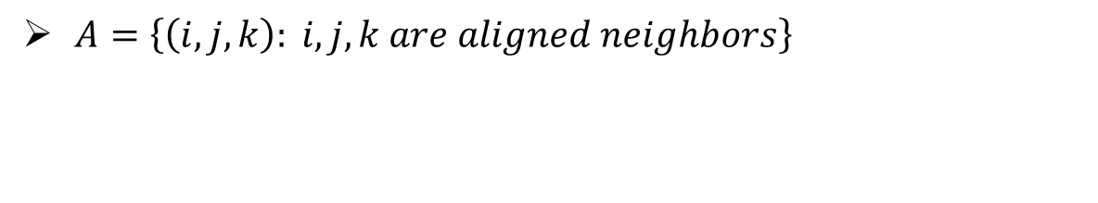
Definitions (3) - Sets
$A=\left\{\left(i,j,k\right): i,j,k are aligned neighbors\right\}$

Slide 23
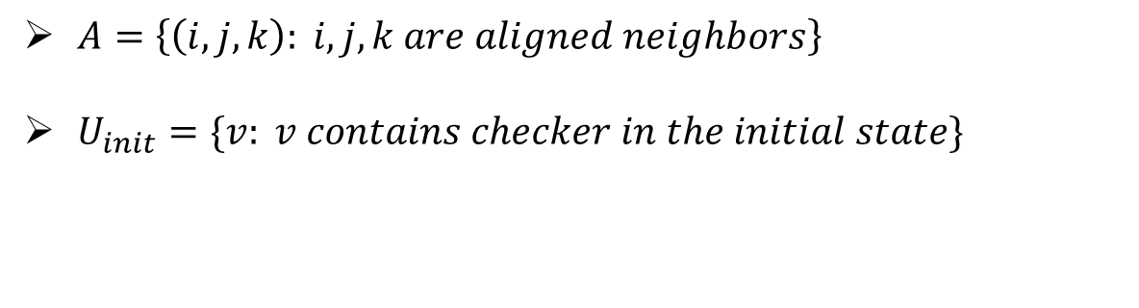
Definitions (3) - Sets
$A=\left\{\left(i,j,k\right): i,j,k are aligned neighbors\right\}$
$U_{init}=\{v: v contains checker in the initial state\}$

Slide 24
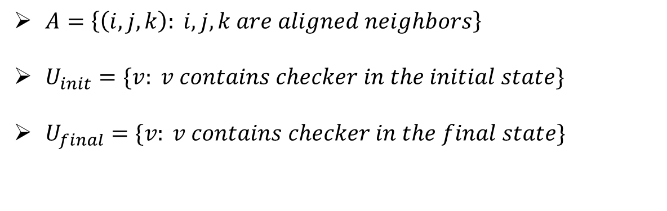
Definitions (3) - Sets
$A=\left\{\left(i,j,k\right): i,j,k are aligned neighbors\right\}$
$U_{init}=\{v: v contains checker in the initial state\}$
$U_{final}=\{v: v contains checker in the final state\}$

Slide 25
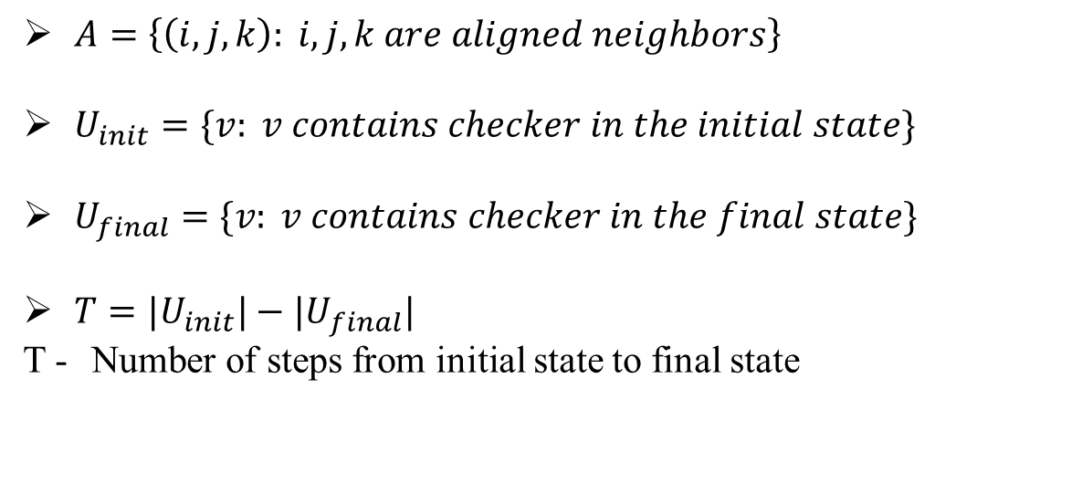
Definitions (3) - Sets
$A=\left\{\left(i,j,k\right): i,j,k are aligned neighbors\right\}$
$U_{init}=\{v: v contains checker in the initial state\}$
$U_{final}=\{v: v contains checker in the final state\}$
$T={|U}_{init}{|−|U}_{final}|$
T - Number of steps from initial state to final state

Slide 26
Definitions (4) - Variables

Slide 27
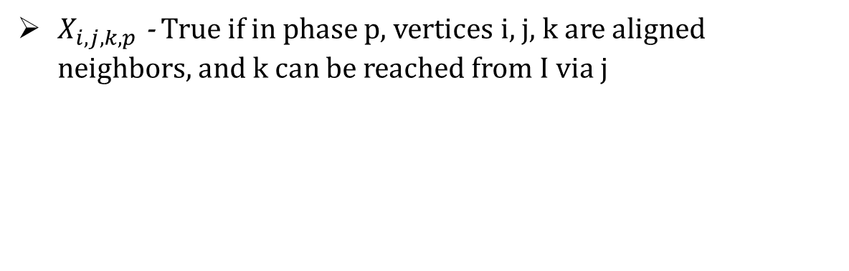
Definitions (4) - Variables
$X_{i,j,k,p}$ - True if in phase p, vertices i, j, k are aligned neighbors, and k can be reached from I via j

Slide 28
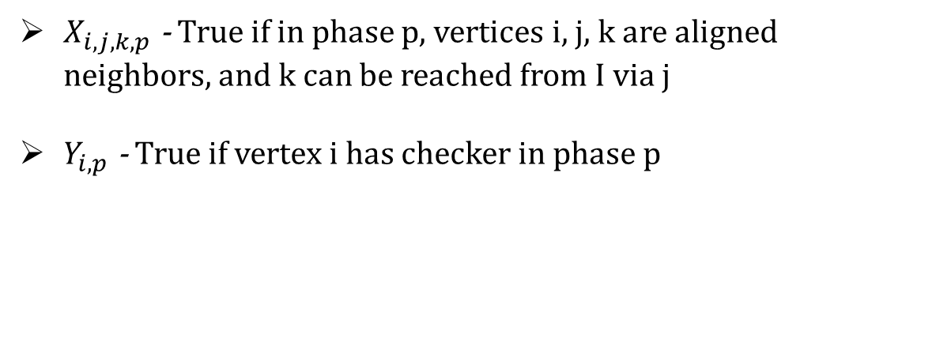
Definitions (4) - Variables
$X_{i,j,k,p}$ - True if in phase p, vertices i, j, k are aligned neighbors, and k can be reached from I via j
$Y_{i,p}$ - True if vertex i has checker in phase p

Slide 29
Constraints –Boolean Logic

Slide 30
Formulas (1)

Slide 31
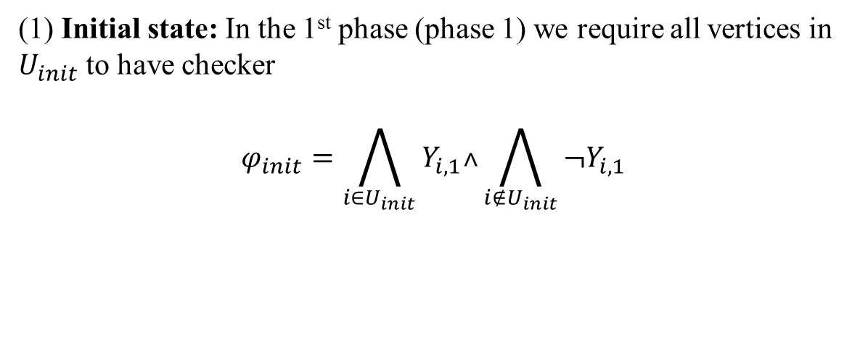
Formulas (1)
(1) Initial state: In the 1st phase (phase 1) we require all vertices in $U_{init}$ to have checker
$$φ_{init}=\bigwedge_{i∈U_{init}}{Y_{i,1}˄\bigwedge_{i{∉U}_{init}}{¬Y_{i,1}}}$$

Slide 32
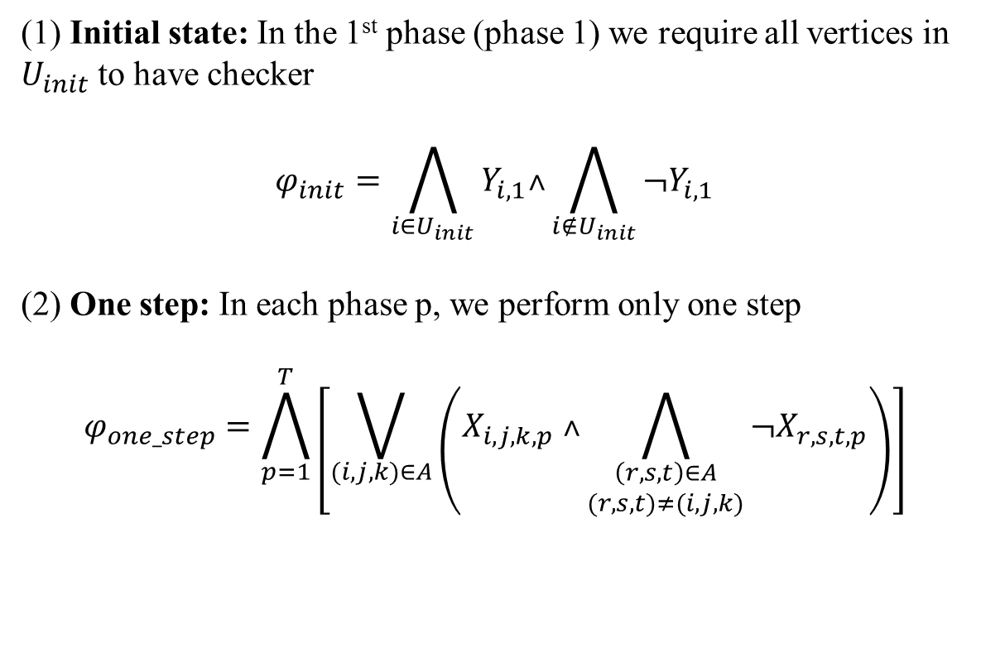
Formulas (1)
(1) Initial state: In the 1st phase (phase 1) we require all vertices in $U_{init}$ to have checker
$$φ_{init}=\bigwedge_{i∈U_{init}}{Y_{i,1}˄\bigwedge_{i{∉U}_{init}}{¬Y_{i,1}}}$$
(2) One step: In each phase p, we perform only one step
$$φ_{one_step}=\bigwedge_{p=1}^{T}{\left[\bigvee_{(i,j,k)∈A}{\left(X_{i,j,k,p} ˄\bigwedge_{\begin{aligned}\left(r,s,t\right)∈A \\ (r,s,t)≠(i,j,k)\end{aligned}}{{¬X}_{r,s,t,p}}\right)}\right]}$$

Slide 33
Formulas (2)

Slide 34

Formulas (2)
(3) Legal step: In each phase p there is at least one legal step
$$φ_{legal}=\bigwedge_{p=1}^{T}{\left[\bigvee_{(i,j,k)∈A}{\left(Y_{i,p}˄Y_{j,p}{˄¬Y}_{k,p}˄X_{i,j,k,p}\right)}\right]}$$

Slide 35
Formulas (3)

Slide 36
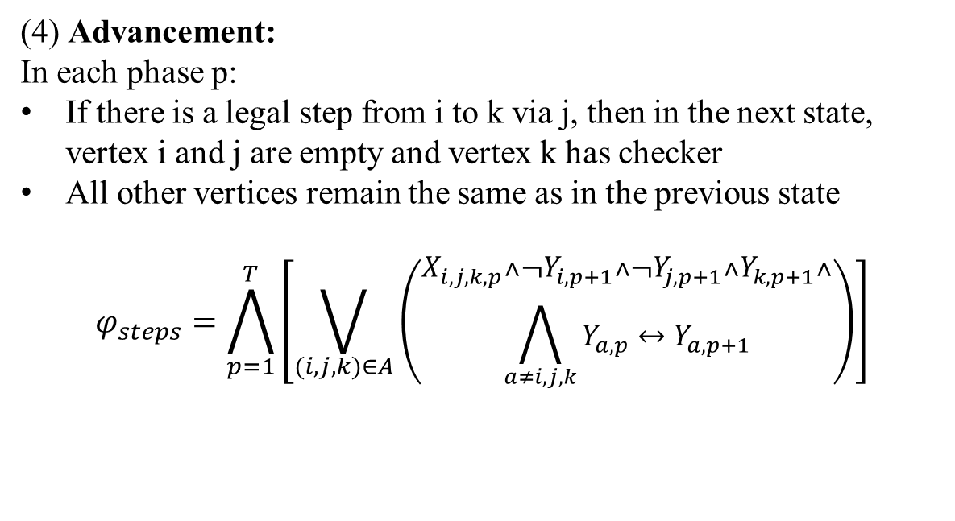
Formulas (3)
(4) Advancement:
In each phase p:
If there is a legal step from i to k via j, then in the next state, vertex i and j are empty and vertex k has checker
All other vertices remain the same as in the previous state
$$φ_{steps}=\bigwedge_{p=1}^{T}{\left[\bigvee_{(i,j,k)∈A}{\left(\begin{aligned}X_{i,j,k,p}{˄¬Y}_{i,p+1}{˄¬Y}_{j,p+1}{˄Y}_{k,p+1}˄ \\ \bigwedge_{a≠i,j,k}{Y_{a,p}{↔Y}_{a,p+1}}\end{aligned}\right)}\right]}$$

Slide 37
Formulas (4)

Slide 38
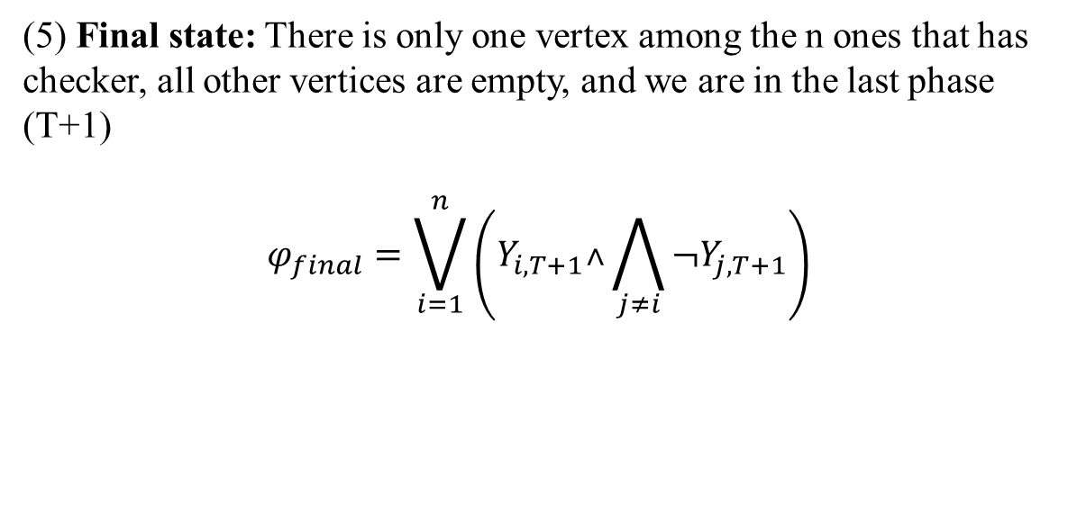
Formulas (4)
(5) Final state: There is only one vertex among the n ones that has checker, all other vertices are empty, and we are in the last phase (T+1)
$$φ_{final}=\bigvee_{i=1}^{n}{\left(Y_{i,T+1}˄\bigwedge_{j≠i}{{¬Y}_{j,T+1}}\right)}$$

Slide 39
Final Formula

Slide 40
Final Formula
We would like to check the satisfiability of the formula:

Slide 41
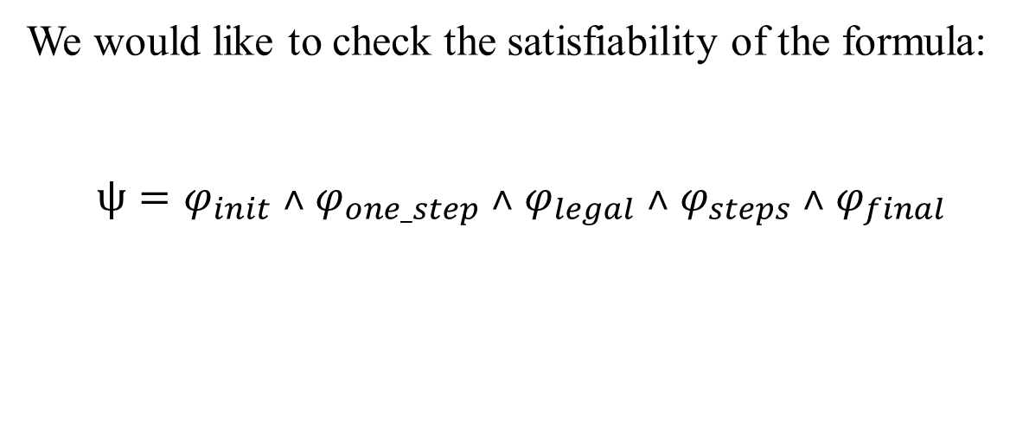
Final Formula
We would like to check the satisfiability of the formula:
$$ψ=φ_{init}{ ˄ φ}_{one_step}{ ˄ φ}_{legal}{ ˄ φ}_{steps}{ ˄ φ}_{final}$$

Slide 42
Logical Modeling Advanced Game

Slide 43
Advanced Game

Slide 44
Advanced Game
We allow the player to set both the initial board and the final board

Slide 45
Advanced Game
We allow the player to set both the initial board and the final board
All first 4 formulas remain the same

Slide 46
Advanced Game
We allow the player to set both the initial board and the final board
All first 4 formulas remain the same
We change only the 5th formula:

Slide 47
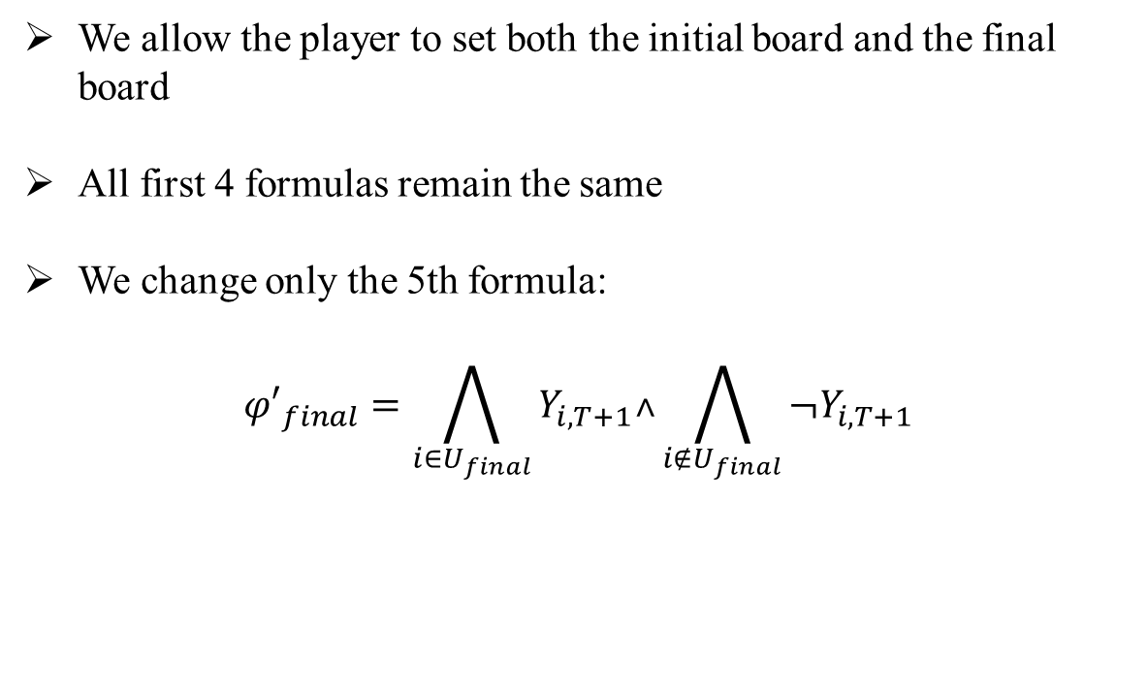
Advanced Game
We allow the player to set both the initial board and the final board
All first 4 formulas remain the same
We change only the 5th formula:
$${φ′}_{final}=\bigwedge_{i∈U_{final}}{Y_{i,T+1}˄\bigwedge_{i{∉U}_{final}}{{¬Y}_{i,T+1}}}$$

Slide 48
Implementation

Slide 49
Technologies

Slide 50

Technologies

Slide 51

Technologies

Slide 52

Technologies

Slide 53

Technologies

Slide 54
Technologies
Pycosat

Slide 55
Flow Diagram
MainForm

Slide 56
Flow Diagram
MainForm
board
GameLogic

Slide 57
Flow Diagram
MainForm
board
GameLogic
FormulaGenerator

Slide 58
Flow Diagram
MainForm
board
GameLogic
FormulaGenerator
Boolean Logic Formula

Slide 59
Flow Diagram
MainForm
board
GameLogic
FormulaGenerator
Boolean Logic Formula
CnfConverter

Slide 60
Flow Diagram
MainForm
board
GameLogic
FormulaGenerator
Boolean Logic Formula
CnfConverter
CNF Formula

Slide 61
Flow Diagram
MainForm
board
GameLogic
FormulaGenerator
Boolean Logic Formula
CnfConverter
CNF Formula
SAT Solver

Slide 62
Flow Diagram
MainForm
board
GameLogic
FormulaGenerator
Boolean Logic Formula
Result
CnfConverter
CNF Formula
SAT Solver

Slide 63
Flow Diagram
MainForm
Path
board
SolutionForm
GameLogic
FormulaGenerator
Boolean Logic Formula
Result
CnfConverter
CNF Formula
SAT Solver

Slide 64
Flow Diagram
MainForm
Path
board
“UNSAT”
SolutionForm
GameLogic
FormulaGenerator
Boolean Logic Formula
Result
CnfConverter
CNF Formula
SAT Solver

Slide 65
Blocks Diagram

Slide 66
Blocks Diagram
OriginalIQTesterApp
MainForm
ResultsForm
Board

Slide 67
Blocks Diagram
OriginalIQTesterApp
MainForm
ResultsForm
Board
OriginalIQTesterLogic
GameLogic

Slide 68
Blocks Diagram
OriginalIQTesterApp
MainForm
ResultsForm
Board
OriginalIQTesterLogic
GameLogic
Logic
CnfConverter
FormulaGenerator
Tsietin
Variable
ExpressionTree
Tree

Slide 69
Blocks Diagram
OriginalIQTesterApp
MainForm
ResultsForm
Board
OriginalIQTesterLogic
GameLogic
Logic
Graphs
CnfConverter
FormulaGenerator
Graph
Tsietin
Variable
Vertex
ExpressionTree
Tree

Slide 70
Blocks Diagram
OriginalIQTesterApp
MainForm
ResultsForm
Board
Sat
SatSolver
OriginalIQTesterLogic
SolutionBuilder
GameLogic
Logic
Graphs
CnfConverter
FormulaGenerator
Graph
Tsietin
Variable
Vertex
ExpressionTree
Tree

Slide 71
Blocks Diagram
satSolver.py
OriginalIQTesterApp
MainForm
ResultsForm
Board
Sat
SatSolver
OriginalIQTesterLogic
SolutionBuilder
GameLogic
Logic
Graphs
CnfConverter
FormulaGenerator
Graph
Tsietin
Variable
Vertex
ExpressionTree
Tree

Slide 72
Blocks Diagram
satSolver.py
OriginalIQTesterApp
MainForm
ResultsForm
Board
Sat
SatSolver
OriginalIQTesterLogic
SolutionBuilder
GameLogic
Resources
Logic
Graphs
CnfFileGenerator
CnfConverter
FormulaGenerator
Graph
Tsietin
Variable
Vertex
ExpressionTree
Tree

Slide 73
Blocks Diagram
satSolver.py
OriginalIQTesterApp
Utilities
MainForm
ResultsForm
Board
Sat
Constants
SatSolver
Logger
OriginalIQTesterLogic
SolutionBuilder
GameLogic
Resources
Logic
Graphs
CnfFileGenerator
CnfConverter
FormulaGenerator
Graph
Tsietin
Variable
Vertex
ExpressionTree
Tree

